Slide 1
Chapter 11 – Configuring Windows Group Policy
Notes:
Presentation: 90 minutes
Lab: 80 minutes
After completing this module, students will be able to:
Explain what Group Policy is.
Implement and administer Group Policy Objects (GPOs).
Describe Group Policy scope and Group Policy processing.
Troubleshoot GPO application.
Required materials
To teach this module, you need the Microsoft Office PowerPoint file 20742B_05.pptx.
Preparation tasks
To prepare for this module:
Read all of the materials for this module.
Practice performing the demonstrations and labs.
Work through the Module Review and Takeaways section and determine how you will use the information to reinforce student learning and promote knowledge transfer to on-the-job performance.
As you prepare for this class, it is imperative that you complete the labs yourself. This gives you an understanding of how the labs work and the concepts that each covers, so that you can provide meaningful hints to students who might have issues. Furthermore, it will help guide your lecture to ensure that you discuss the concepts that the labs cover.
20742B
5: Implementing Group Policy

Slide 2
Chapter Overview
Introducing Group Policy
Implementing and administering GPOs
Group Policy scope and Group Policy processing
Troubleshooting the application of GPOs
Notes:
Introduce the core components and functionality of the Group Policy infrastructure based on Windows operating systems. Prepare students for managing GPOs, GPO links, and GPO processing.
20742B
5: Implementing Group Policy

Slide 3
Introducing Group Policy
What is configuration management?
Overview of Group Policy tools and consoles
Demonstration: Exploring Group Policy tools and consoles
Benefits of using Group Policy
Group Policy Objects
Overview of GPO scope
Overview of GPO inheritance
The Group Policy Client service and client-side extensions
New features in Group Policy in
Windows Server 2016
Notes:
In this lesson, provide an overview of Group Policy. The goal of this lesson is to introduce the core concepts, terms, and components of Group Policy so that students have a big-picture understanding of Group Policy. They must see the overview and have a familiarity for the pieces and how they fit together. Do not go into too much detail about any one concept, term, or component. Remaining lessons in this module provide greater detail about each concept, term, and component.
We recommend that you read the text in the student manual for this lesson and use that text as a guide or even as a script for delivering this module. The text provides just enough detail to get students on the same page, regardless of their previous experience levels.
We also recommended that rather than stepping through the slides, you demonstrate functionalities as much as possible in the UI while you discuss policy settings, GPOs, and GPO links. Again, the text in the Workbook provides a guide for the demonstrations. You can use the policy setting that restricts access to the registry tools and then follow that through a GPO, linking the GPO to an organizational unit (OU), and then perhaps even showing the results of the GPO on a client.
Categorize Activity
Question
Categorize each item into the appropriate category. Indicate your answer by writing the category number to the right of each item.
Answer
Category 1: Can link GPOs to
Domain
Organizational unit
Site
20742B
5: Implementing Group Policy
(More notes on the next slide)

Slide 4
What is configuration management?
Configuration management is a centralized approach to applying one or more changes to more than one user or computer
The key elements of configuration management are:
  Setting
  Scope
  Application
Notes:
Because there are so many components within Group Policy, it is helpful to start by taking a step back from the technology. Make sure that students understand the broad concept and business value of configuration management.
By presenting configuration management as three elements—setting, scope, and application—you create a framework in the students’ minds for understanding the role of each Group Policy component. Explain that with configuration management, and Group Policy, in particular, information technology (IT) administrators can automate the management of users and computers. This simplifies administrative tasks and reduces IT costs. Administrators can implement security settings, enforce IT policies, and distribute software consistently for the local computer or across a given site, domain, or range of OUs.
The information assurance topic that builds the case for GPO usage is configuration management. This is an industry best practice that requires emphasis. Resultant Set of Policy (RSoP) also provides good documentation for the standardization of computers and user accounts. Furthermore, this is a good place to mention how an organization’s security posture improves with the effective use of Group Policy. GPOs also are a method for mitigating the risk associated with specific security threats that organizations face.
20742B
5: Implementing Group Policy

Slide 5
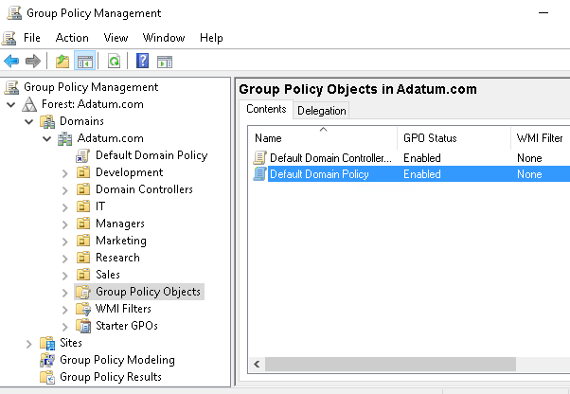
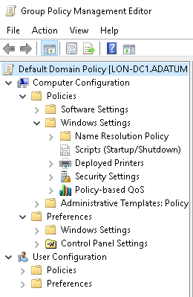
Overview of Group Policy tools and consoles
Group Policy Management Console
Group Policy Management Editor
Command-line utilities: GPUpdate and GPResult
Notes:
20742B
5: Implementing Group Policy

Slide 6
Benefits of using Group Policy
Group Policy is a very powerful administrative tool
You can use it to enforce various types of settings to a large number of users and computers
Typically, you use GPOs to:
  Apply security settings
  Manage desktop application settings
  Deploy application software
  Manage Folder Redirection
  Configure network settings
Notes:
Consider demonstrating some of the settings that the slide lists.
20742B
5: Implementing Group Policy

Slide 7
Group Policy Objects
A GPO is:
A container for one or more policy settings
Managed with the GPMC
Stored in the GPOs container
Edited with Group Policy Management Editor
Applied to a specific level in the AD DS hierarchy
Notes:
Consider demonstrating each point in the slide to help reinforce student understanding.
20742B
5: Implementing Group Policy

Slide 8
Overview of GPO scope
The scope of a GPO is the collection of users and computers that will apply the settings in the GPO
You can use several methods to scope a GPO:
  Link the GPO to a container, such as an OU
  Filter by using security settings
  Filter by using WMI filters
For Group Policy preferences:
  You can filter or target the settings that you configure by Group Policy preferences within a GPO based on several criteria
Notes:
Mention that a GPO, and all of the settings that it contains, does not take effect until you have defined its scope. The first step to scoping a GPO is linking it to a site, domain, or OU. Introduce students to the mnemonic device: Site-Domain-OU (S-D-OU).
Emphasize that GPOs apply to users and computers only, and not to groups, despite the Group Policy name. If you choose to demonstrate the points on the slide, create a new GPO, and then link it to the domain. Emphasize the idea that the link or links define the maximum scope of the GPO.
Discussion prompt: Pose a question: What if you do not want the GPO settings to apply to all objects within the scope?
Use the question to transition to the concept of security group filtering, emphasizing that such filtering creates a subset of objects within the broader scope of the GPO link.
Important note:
Many experienced administrators rely too heavily on GPO links to manage the scope of GPOs. This often leads to less-than-ideal design of Active Directory Domain Services (AD DS) OUs at the expense of efficiently applied and managed security, such as with access control lists (ACLs) and delegation.
Continue with a very brief discussion of Windows Management Instrumentation (WMI) filtering, keeping the discussion at a high level. Use the example of a policy setting that you want to apply to a certain operating system only. Define WMI filtering as a way of querying the system and then determining whether to apply a GPO.
End the discussion with a mention of preferences targeting. The goal is simply to introduce the term and to prepare students for the idea that it is now possible to apply only part of a GPO to clients, as long as that part is only a segment of preferences.
20742B
5: Implementing Group Policy

Slide 9
Overview of GPO inheritance
GPOs are processed on a client computer in the following order:
Local GPOs
Site-level GPOs
Domain-level GPOs
OU GPOs, including any nested OUs
Notes:
While you explain that there are exceptions to the typical precedence in Group Policy processing, explain when you would use each of the following options:
Link Order. To ensure that a specific GPO linked to an OU has precedence at that OU.
Enforced. To apply standardized settings for an organization or department.
Block Inheritance. To allow a department to operate independently of the GPOs applied in the rest of the organization.
Link Enabled. To disable processing of a GPO during troubleshooting.
20742B
5: Implementing Group Policy

Slide 10
The Group Policy Client service and client-side extensions
Group Policy application process:
  Group Policy Client retrieves GPOs
  Client downloads and caches GPOs
  Client-side extensions process the settings
Policy settings in the Computer Configuration node apply at system startup and every 90–120 minutes thereafter
Policy settings in the User Configuration node apply at sign-in and every 90–120 minutes thereafter
Notes:
Use this topic to introduce the fact that Group Policy is applied by using client-side pull processes. Introduce students to the idea that there are two major phases to an application. First, the Group Policy Client service asks AD DS which GPOs to apply. Then, enhanced GPOs go to the client-side extensions, which apply the settings.
Present the fact that most Group Policy client-side extensions apply settings only if the GPO has changed. This improves performance by eliminating unnecessary reapplications of the same settings.
You also might choose to discuss the Always Wait For Network At Startup And Logon policy setting as you discuss Group Policy refresh and application. Information about this setting is presented in the Workbook.
20742B
5: Implementing Group Policy

Slide 11
New features in Group Policy in Windows Server 2016
Windows Server 2016 introduces a few changes and improvements to Group Policy, including:
Importing the following types of policy settings on Nano Server:
  Registry settings
  Security settings
  Audit settings
Including Windows 10 administrative templates
Notes:
Discuss the changes and improvements with students.
20742B
5: Implementing Group Policy

Slide 12
Implementing and administering GPOs
What are domain-based GPOs?
GPO storage
What are starter GPOs?
Common GPO management tasks
Delegating administration of Group Policy
Demonstration: Delegating administration of Group Policy
Notes:
In this lesson, you will discuss how to implement Group Policy. Stay focused on the fundamentals in this module. The next module will take the students’ knowledge a step further.
Question
Members of which built-in AD DS groups can create GPOs by default? (Select three.)
( ) Option 1: Domain Admins
( ) Option 2: Account Operators
( ) Option 3: Enterprise Admins
( ) Option 4: GPO Admins
( ) Option 5: Group Policy Creator Owners
Answer
(√ ) Option 1: Domain Admins
( ) Option 2: Account Operators
(√ ) Option 3: Enterprise Admins
( ) Option 4: GPO Admins
(√ ) Option 5: Group Policy Creator Owners
Feedback
The GPO Admins group does not exist. The Domain Admins and Enterprise Admins groups can perform all administrative tasks in the domain including create GPOs. Group Policy Creator Owners is the only group that you can add users to if you want them to be able to create GPOs without getting administrative rights on the domain or forest. Account Operators do not have any permissions regarding Group Policy. Only administering users, computers and groups in AD DS.
20742B
5: Implementing Group Policy

Slide 13
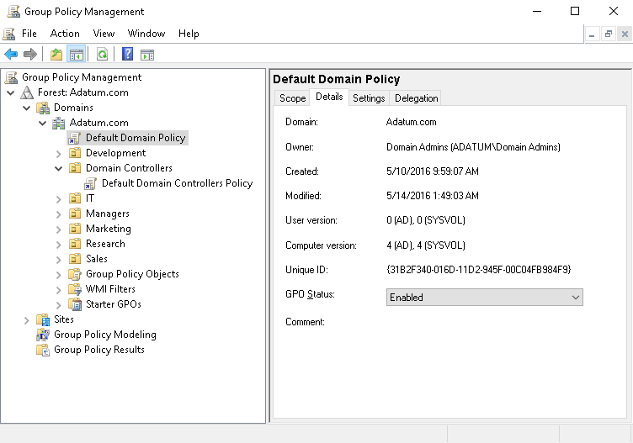
What are domain-based GPOs?
Notes:
Explain the purpose of the two default domain-based GPOs. Also, tell students that we do not recommend that they change settings in these GPOs. Rather, they should create new ones. Emphasize that Default Domain Controllers Policy is used only on domain controllers.
Briefly mention local GPOs, but do not focus much on them. Emphasize that domain-based GPOs take precedence because of the processing order.
20742B
5: Implementing Group Policy

Slide 14

GPO storage
Group Policy container
GPO
Stored in AD DS
Provides version information
Group Policy template
Contains Group Policy settings
Stores content in two locations
Stored in shared SYSVOL folder
Provides Group Policy settings
Notes:
Consider showing students the Group Policy template and Group Policy container.
20742B
5: Implementing Group Policy

Slide 15
What are starter GPOs?
A starter GPO:
Stores administrative template settings on which new GPOs will be based
Can be exported to .cab files
Can be imported into other areas of an organization
Exported to .cab file
Imported to the GPMC
Starter GPO
.cab file
Load
.cab file
Notes:
Explain that you can store preconfigured administrative template settings in starter GPOs that act as templates for creating new GPOs. You can export these starter GPOs into .cab files that you can import easily into other areas of your organization. This can help provide consistency in large organizations. You can store comments about the starter GPO in the template itself.
20742B
5: Implementing Group Policy

Slide 16
Common GPO management tasks
You can manage GPOs by using GPMC or Windows PowerShell. These are some of the options for managing the state of GPOs:
Back up GPOs
Restore GPOs
Copy GPOs
Import GPOs
Notes:
Like critical data and AD DS–related resources, you must backup GPOs to protect the integrity of AD DS and GPOs. The GPMC not only provides the basic backup and restore options, but it also provides additional control over GPOs for administrative purposes, including that:
You can back up GPOs individually or as a whole with the GPMC.
The restore interface provides the ability for you to view the settings stored in the backed-up version before restoring it.
If you import a GPO, you can transfer settings from a backed-up GPO to an existing GPO. It does not modify the existing security or links on the destination GPO.
You can copy GPOs by using the GPMC, both in the same domain and across domains.
Consider demonstrating how to perform these tasks.
20742B
5: Implementing Group Policy

Slide 17
Delegating administration of Group Policy
Delegation of GPO-related tasks allows the administrative workload to be distributed across the enterprise
You can delegate the following Group Policy tasks independently:
  Creating GPOs
  Editing GPOs
  Managing Group Policy links for a site, domain, or OU
  Performing Group Policy modeling analysis in a domain or OU
  Reading Group Policy results data in a domain or OU
  Creating WMI filters in a domain
Notes:
Explain that you can delegate different aspects of GPO management. Emphasize that creating, linking, and editing GPOs are three separate operations and that having the right to perform one of these operations does not give you any rights to perform other operations. The administrator is the only user who has the rights to perform all of these actions by default.
You can use Delegation of Control Wizard or the GPMC to delegate linking GPOs and to enable the use of reporting tools. Explain that you can use membership in the Group Policy Creator Owners group or through the GPMC to delegate the right to create new group policies. You can configure each policy to allow users or groups to edit that policy.
Members of the Group Policy Creator Owners group can create new GPOs and edit or delete the GPOs that they create.
Consider demonstrating how to perform these tasks.
20742B
5: Implementing Group Policy

Slide 18
Group Policy scope and Group Policy processing
What are GPO links?
Group Policy processing order
Configuring GPO inheritance and precedence
Using security filtering to modify Group Policy scope
What are WMI filters?
Demonstration: Filtering Group Policy application
How to enable or disable GPOs and GPO nodes
Loopback policy processing
Considerations for slow links and disconnected systems
Identifying when settings become effective
Notes:
Question
It is possible to link more than one WMI filter to a GPO.
( ) False
( ) True
Answer
(√ ) False
( ) True
Feedback
Although you cannot link more than one WMI filter to a GPO, you can create advanced WMI filters that include more than one WMI query.
20742B
5: Implementing Group Policy
(More notes on the next slide)

Slide 19
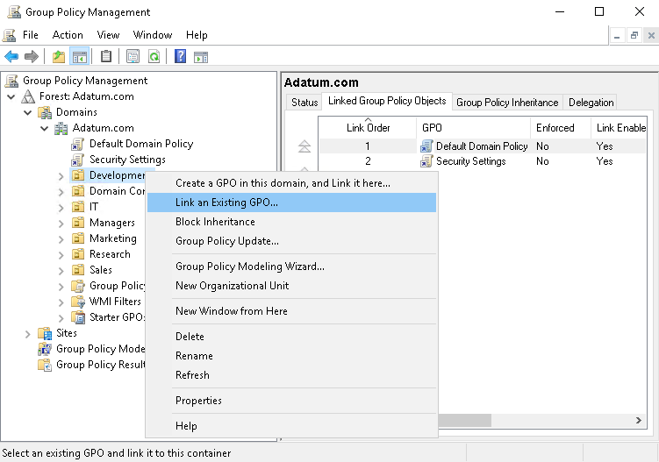
What are GPO links?
After you have linked a GPO, the users or computers in that container are within the scope of the GPO, including computers and users in child OUs
Notes:
The key point of this topic is to explain what students can do with GPO links. It is very important to emphasize that a GPO link actually connects Group Policy settings to a container in AD DS. Also, explain in which state the link can be and the differences between these states.
Consider demonstrating each of the activities described in the topic.
20742B
5: Implementing Group Policy

Slide 20
Group Policy processing order
GPO 1
Local group
. . .
Local group policies
GPO 2
Site
. . .
Site group policies
GPO 3
. . .
Domain group policies
Domain
GPO 4
OU
. . .
OU group policies
. . .
Child OU group policies
GPO 5
OU
Notes:
Illustration depicting the generic Group Policy application order. You can use it to modify and enforce the L-S-D-OU (L-S-D-OU) mnemonic.
20742B
5: Implementing Group Policy

Slide 21
Configuring GPO inheritance and precedence
The application of GPOs linked to each container results in a cumulative effect called policy inheritance:
  Default precedence: Local → Site → Domain → OU → Child OU… (LSDOU)
  Visible on the Group Policy Inheritance tab
Link order (attribute of GPO link):
  Lower number → Higher on list → Precedence
Block Inheritance (attribute of OU):
  Blocks the processing of GPOs from a higher level
Enforced (attribute of GPO link):
  Enforced GPOs override Block Inheritance
  Enforced GPO settings win over conflicting settings in lower GPOs
Notes:
While you discuss Group Policy inheritance and precedence, make sure that students understand that what is called inheritance is really just the effect of repeated, layered application of settings in GPOs, in a specific order.
Consider demonstrating this topic’s points by creating GPOs and then enforcing them. It is not necessary to show the effect of the enforcement. Also, demonstrate the procedure for blocking inheritance. Again, merely show the procedure.
20742B
5: Implementing Group Policy

Slide 22
Using security filtering to modify Group Policy scope
Apply Group Policy permission:
  GPO has an ACL (Delegation tab → Advanced)
  Members of the Authenticated Users group have Allow Apply Group Policy permissions by default
To scope only to users in selected global groups:
  Remove the Authenticated Users group
  Add appropriate global groups: Must be global groups (GPOs do not scope to domain local)
To scope to users except for those in selected groups:
  On the Delegation tab, click Advanced
  Add appropriate global groups
  Deny the Apply Group Policy permission
Notes:
Many organizations struggle with how to maintain governance over Group Policy and, specifically, how to test a GPO effectively before using it in production. Talk through a simple but effective best practice: using security group filtering to manage the scope of a GPO during testing. Instead of creating a child OU to manage the GPO’s scope for testing, link the GPO to the location to which it belongs in production. But instead of allowing the GPO to apply to the Authenticated Users group, or to the production security group, configure a security group specifically designed to limit the scope of the GPO to appropriate users and computers. The benefit of this practice is that it gives a much more realistic picture of how the GPO will perform in production because you are not artificially limiting its scope or precedence by linking it to a separate test OU. In other words, you get a better picture for how the GPO interacts with other GPOs that are already in production. And yet, you still maintain full control over the specific users and computers that are within the test’s scope.
Tip: If you remove the Authenticated Users group, and then scope a GPO to a specific group, support personnel will not be able to read the policy to perform Group Policy management tasks. Be sure to assign appropriate support personnel the Read permission to the GPO, but do not assign them the Apply Policy permission.
Consider demonstrating the points raised in this topic as you discuss them.
20742B
5: Implementing Group Policy

Slide 23
What are WMI filters?
WMI queries can filter GPOs based on system characteristics, including:
    RAM
    Processor speed
    Disk capacity
    IP address
    Operating system version
WMI queries are written by using WQL, for example
  select * from Win32_OperatingSystem where Version like "10.%"
WMI filters can be expensive in terms of Group Policy processing performance
Notes:
Note: This topic has one additional slide.
You should be familiar with the basic functionality of WMI queries, which this section discusses.
Remember that WMI filters can query based on services and processes on a system, not just hardware.
Consider demonstrating the creation and application of a WMI filter. Use the example in the student manual for this purpose.
Mention to the students that depending on the specific WMI query, processing can be a performance issue. Also, use your own experience and mention any WMI filters that you have used in the past.
20742B
5: Implementing Group Policy

Slide 24
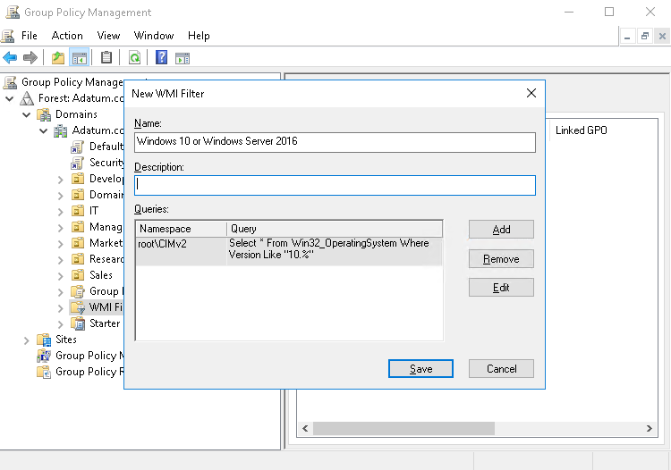
What are WMI filters?
Notes:
20742B
5: Implementing Group Policy

Slide 25
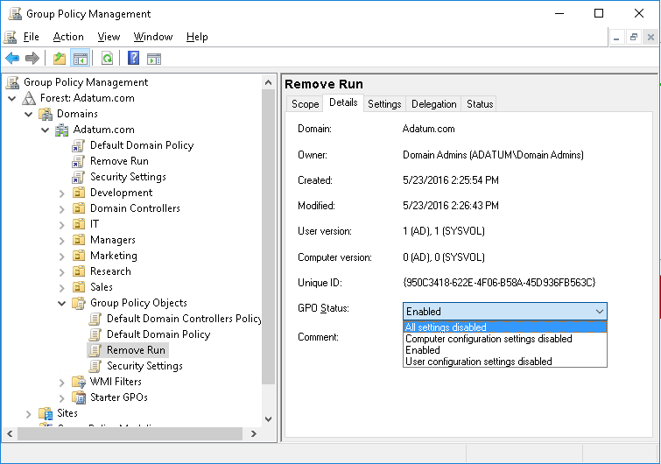
How to enable or disable GPOs and GPO nodes
Notes:
In addition to explaining the settings in the GPO Status drop-down list, mention the performance benefits gained specifically by disabling nodes of GPOs that have no settings.
Discussion Prompt: Ask students to consider what scenarios might lead to disabling a GPO that has settings. Answers might include GPOs that configure strict lockdown in the event of a security incident or GPOs that configure disaster recovery settings. In other words, those that are disabled until needed.
20742B
5: Implementing Group Policy

Slide 26
Loopback policy processing
Provides the ability to apply user Group Policy settings based on the computer to which the user is signing in
Replace mode:
  Only the list of GPOs based on the computer object is used
Merge mode:
  The list of the GPOs based on the computer have higher precedence than the list of GPOs based on the user
Useful in closely managed environments and special-use computers, such as:
  Terminal servers, public-use computers, and classrooms
Notes:
Note: This topic has one additional slide.
Both the user objects and the computer objects potentially can have different Group Policy settings applied, depending on where each object resides in AD DS. Loopback processing ensures that the computer object’s policy takes precedence over the user object’s Group Policy settings.
Loopback processing operates by using the following two modes:
Merge mode applies the user’s normal Group Policy settings and the user settings associated with the location of the computer object. Both sets of policies will be merged, but in the case of a conflict between settings, it will apply the computer loopback policy settings.
Replace mode ignores the user’s normal Group Policy settings and instead applies the user settings associated with the policy that delivered the loopback settings.
For example, a public-access computer in the lobby might have a user policy that locks down the desktop completely and allows access only to certain software. Loopback processing in Replace mode would ensure that whoever signs in to the computer would be subject to those restrictions.
Give examples of when you might implement loopback processing.
This is often one of the harder topics regarding Group Policy to deliver to the students. Ideally, use an example to demonstrate. For example, you could change the CTRL-ALT-DEL options when users sign in to a server.
20742B
5: Implementing Group Policy

Slide 27
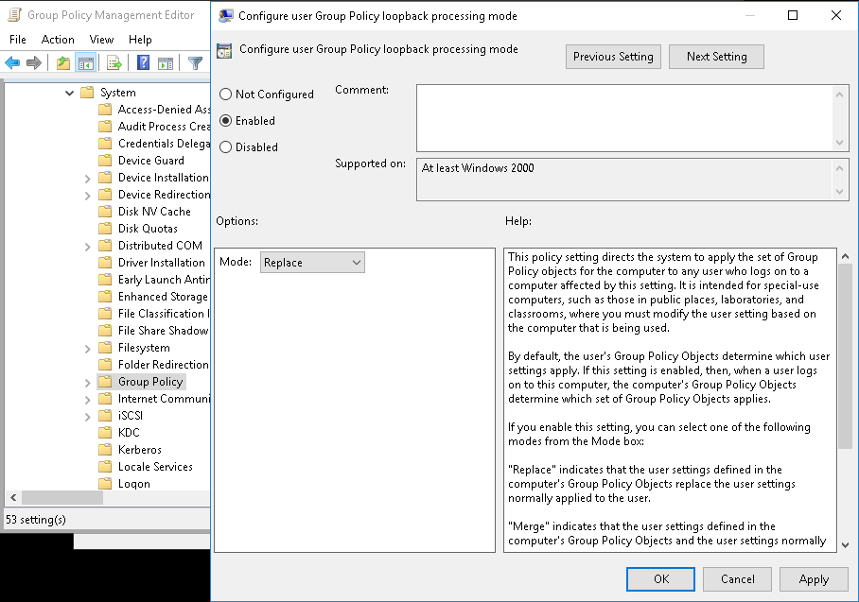
Loopback policy processing
Notes:
20742B
5: Implementing Group Policy

Slide 28
Considerations for slow links and disconnected systems
Slow link detection:
  By default, connection speeds below 500 kbps
  The following CSEs apply by default:
    Security Settings
    Administrative Templates
Disconnected computers:
  Cache Group Policy so that settings still apply
  Perform Group Policy refresh when reconnecting with the domain network if a background refresh has been missed
Notes:
Discuss the issues associated with slow links and disconnected systems. Make sure that students understand that when a computer is disconnected, the previously applied settings will continue to take effect. There are several exceptions to this rule—most notably that startup, shutdown, logon, and logoff scripts do not run when the system is disconnected.
20742B
5: Implementing Group Policy

Slide 29
Identifying when settings become effective
GPO replication must occur
Group changes must replicate
Group Policy refresh must occur
User must sign out and sign in or the computer must restart
You must perform a manual refresh
Most CSEs do not reapply unchanged GPO settings
Notes:
Use this slide to summarize the details regarding when GPO settings actually take effect. This should answer the question, “When I change a policy setting, when will that setting actually be applied to a user or computer?“
The Workbook contains a lot of information that will help you talk about the slide and answer questions from students.
Do not provide too much detail about the replication technologies themselves, but rather, point out that both the Group Policy container and Group Policy template must replicate to the domain controller from which a client obtains its policies. Also, point out that the Group Policy container and Group Policy template use two different replication technologies that are not always in sync.
Other points to make:
We highly recommend that organizations implement the Always Wait For Network At Startup And Logon policy setting. Without that, a change to a policy setting might take several sign out and sign in or restart cycles before it takes effect, and there is no good way to predict the exact timing. To truly manage the application of new policy settings, administrators should enable Always Wait For Network At Startup And Logon. Make sure that students understand that this does not slow down the startup or logon process significantly. Users will not complain that it is noticeably slower. Also, make sure that students understand that when a system is not connected to the network, it ignores this setting, so this setting is not a problem for disconnected laptop computers or tablet users.
Users cannot change most policy settings, particularly managed policy settings. However, if users are administrators of their computers, it is possible for them to change some settings. Those changes will never be reverted to match the settings specified by the GPOs, because most client-side extensions will reapply policy settings only when a GPO has changed. The exceptions to this rule are security settings, which are reapplied every 16 hours, regardless of whether the GPO has changed. If an organization is concerned about enforcing its policy settings, and if it is possible for users to change those settings, then administrators should configure the client-side extensions to reapply policy settings even if the GPO has not changed. They can use Group Policy to configure the policy processing behavior of each CSE.
20742B
5: Implementing Group Policy

Slide 30
Troubleshooting the application of GPOs
Refreshing GPOs
What is RSoP?
Generating RSoP reports
Demonstration: Performing a what-if analysis with Group Policy Modeling Wizard
Examining Group Policy event logs
Detecting Group Policy health issues
Notes:
In this lesson, you will help students understand that in large, networked environments, Group Policy application can be problematic sometimes. It is important that students know how to use the provided tools to help solve Group Policy application issues.
20742B
5: Implementing Group Policy

Slide 31
Refreshing GPOs
When you apply GPOs, remember that:
  Computer settings apply at startup
  User settings apply at sign-in
  Polices refresh at regular, configurable intervals
  Security settings refresh at least every 16 hours
  Policies refresh manually by using:
    The gpupdate command-line utility
    The Windows PowerShell cmdlet Invoke-gpupdate
  With the Remote Group Policy Refresh feature, you can refresh policies remotely
Notes:
Emphasize that changing the refresh interval might affect the performance of both the client computer and the network and therefore should be tested before implementation.
Make sure that students understand the idea of users logging on with cached credentials and the effect that this has on Group Policy settings.
Point out the feature Remote Group Policy Refresh.
20742B
5: Implementing Group Policy

Slide 32
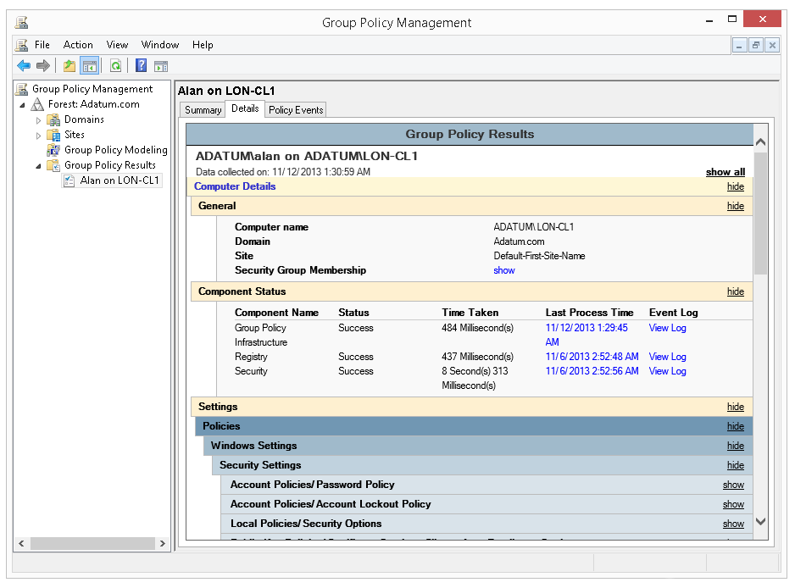
What is RSoP?
RSoP is the net effect of GPOs applied to a user or computer
Group Policy Management
Notes:
Note: this topic has one additional slide
Use this topic to introduce the term, concepts, and tools of RSoP. Remind students how complex it can become to evaluate RSoP with factors including inheritance, filters, loopback, the interaction between GPOs in client-side extensions and the large number of policy settings.
Help students understand that RSoP is both a descriptor that means the end result of policy application and also the name of a collection of tools and processes.
20742B
5: Implementing Group Policy

Slide 33
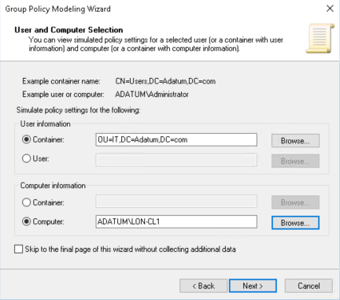
What is RSoP?
Group Policy Modeling Wizard
Notes:
20742B
5: Implementing Group Policy

Slide 34
Generating RSoP reports
RSoP reports show the actual settings being applied to the user and computer
Might show the time taken to apply Group Policy
You can generate RSoP reports by using:
  Group Policy Results Wizard
  GPResults
  Get-GPResultantSetOfPolicy
Target computer must be online
Remote WMI must be enabled
Notes:
Note: This topic has one additional slide.
Talk in detail about RSoP reports, preferably with demonstrations. Make sure that students understand how to generate, interpret, and save RSoP reports created by Group Policy Results Wizard in the GPMC or by the GPResult command.
Emphasize the critical importance of RSoP reports in analyzing and troubleshooting Group Policy application in an enterprise.
20742B
5: Implementing Group Policy

Slide 35
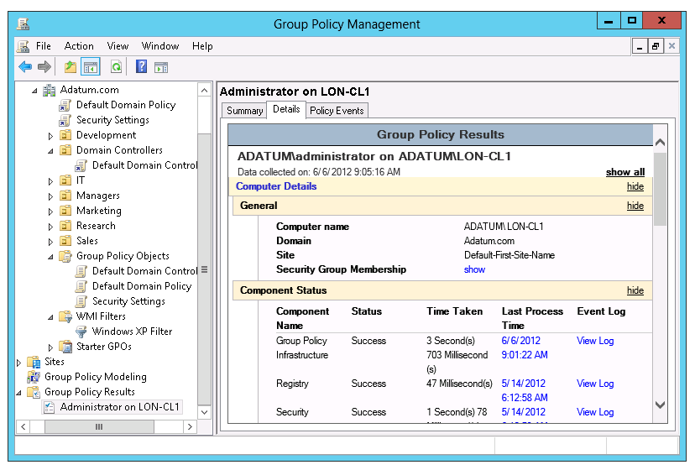
Generating RSoP reports
Notes:
20742B
5: Implementing Group Policy

Slide 36
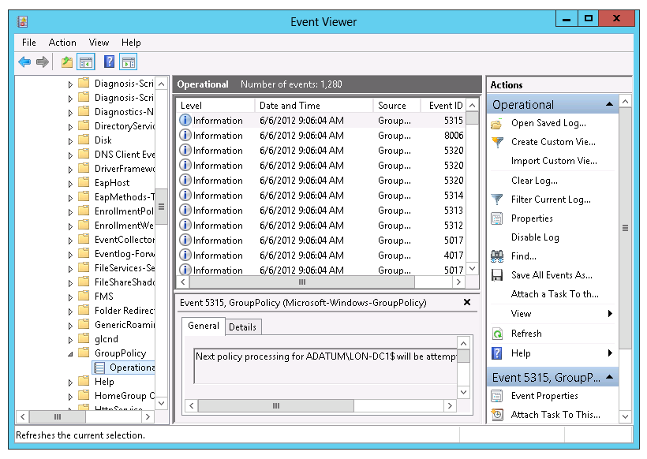
Examining Group Policy event logs
Notes:
Consider demonstrating the three major logs in which you can find Group Policy events. Also, point out that RSoP reports expose Group Policy events, particularly in Advanced View.
Mention that the Group Policy Operational log is a great way to learn exactly how Group Policy is applied in Windows operating systems. You can trace every step of Group Policy application described in the previous lesson.
20742B
5: Implementing Group Policy

Slide 37
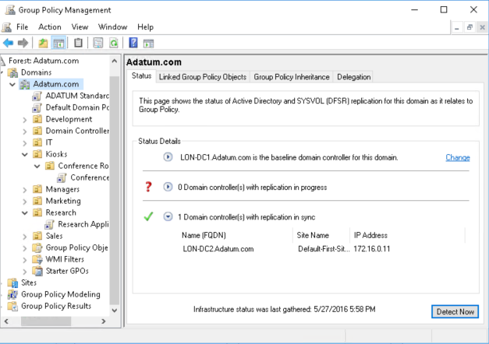
Detecting Group Policy health issues
Group Policy health check in Group Policy Management Console
Notes:
Note: This topic has one additional slide.
Some students might have used the gpotool.exe previously. The health status performed by Group Policy Management Console is more extensive. Consider demonstrating the health check. There is no longer a second domain controller, but you can still demonstrate where to perform this action.
20742B
5: Implementing Group Policy

Slide 38
Detecting Group Policy health issues
In Group Policy Management Console:
The Status tab displays information that indicates the health of the Group Policy infrastructure:
  Domain
  GPO
Information displayed includes:
  Domain controllers
  Permissions on the Group Policy container and the Group Policy template
  GPO replication
  GPO versioning
Domain controllers not reachable or inconsistent with the baseline domain controller are added to the Domain controller(s) with replication in progress list
Notes:
If you want to demonstrate this, you can show where this is done in the GPMC. There is no second domain controller. Mention that this feature was introduced with Windows Server 2012.
20742B
5: Implementing Group Policy

